Slide 1
ENTERTAINMENT

Slide 2
In this unit you learn how to
describe films, music and books
politely disagree with opinion
describe pictures

Slide 3
GRAMMAR Habit
Do you … much?
Do you play video games much?
Do you go out much?
Do you listen to music much?

Slide 4
TALKING ABOUT HABITS
To talk about present habits:
Present Simple
I hardly ever go out these days.
As a rule, I don’t watch much TV.
tend to + verb
I tend to stay in during the week.
I don’t tend to read much (or) tend not to read much

Slide 5
TALKING ABOUT HABITS
This structure is more emphatic that the present simple
will/won’t
I’ll usually listen to music for a while before I go to bed.
I won’t normally get up until 11 or 12 on a Sunday.

Slide 6
TALKING ABOUT HABITS
Present Continuous
The present continuous emphasises that something happens all the time and is often annoying.
He’s always watching TV! He hardly does anything else!

Slide 7
TALKING ABOUT HABITS
Past Simple
Use the past simple to talk about past habits.
I did it every day for ten years, but then I gave up.
used to + verb
I used to eat out a lot, but I can’t afford to these days.
I never used to read much when I was a kid

Slide 8
TALKING ABOUT HABITS
would
Would is often used to talk about past habits. We usually introduce the past habit with used to or the past simple and then add details with would.
We used to go to the beach a lot in summer. Sometimes we’d make a bonfire, and we’d stay up all night telling jokes.

Slide 9
FREQUENCY EXPRESSIONS

Slide 10
You are going to hear the answers eight people gave to different questions that use the structure Do you … much?

Slide 11
Listen to the following extracts and complete 1-8 with the expressions and structures that show habits.
I don’t ………… during the week, though.
Yeah ………….! I take my mp3 player with me everywhere.
Not as much ………………, because I really love it.
Yeah………….. to be honest. I guess I might in the summer.
I don’t pay much attention to it most of the time …………. a big game, if there’s one on.
Yeah, I guess so. I usually play football on a Wednesday and I go running ………….. .
No, ……………. tend to wait for films to come out on cable.
Not as much as I ……………… . I was addicted to The Sims for a while, until my parents banned me. I ………………… sometimes play for 5 hours a day!

Slide 12
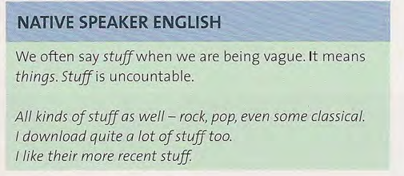

Slide 13
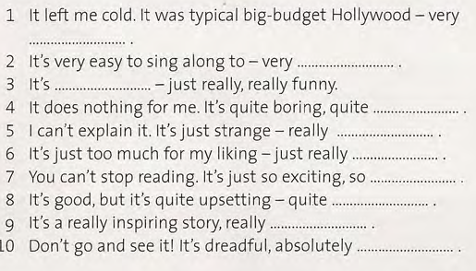

Slide 15
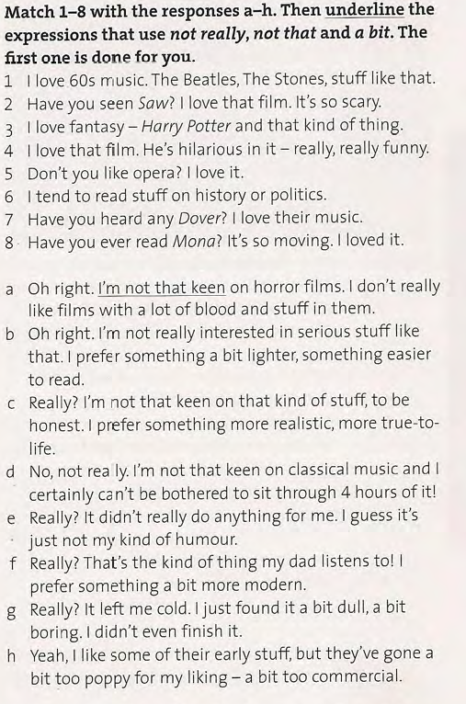

Slide 16
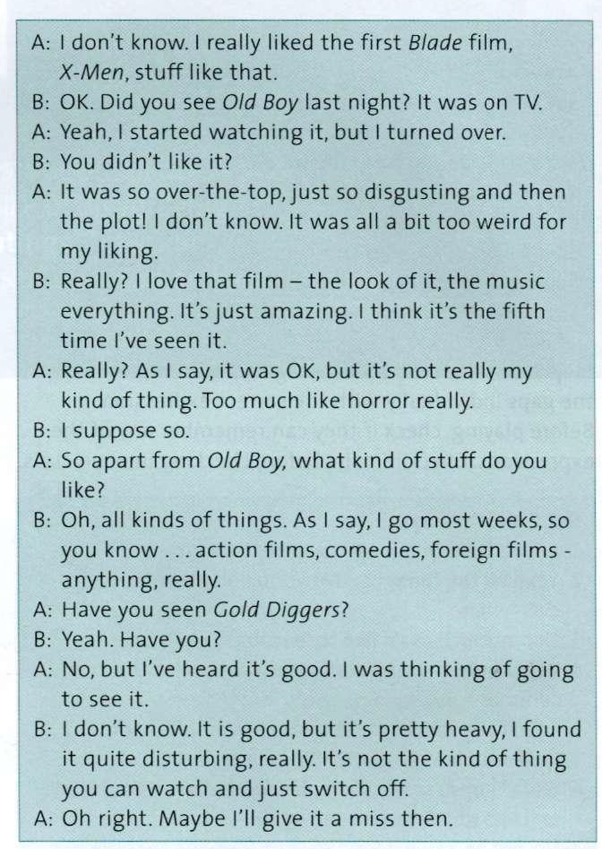
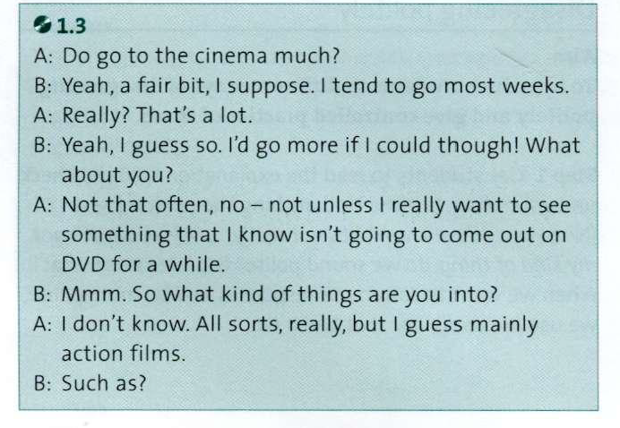

Slide 17
Questions you might ask about films, music, and books
What kind of films are you into? Anything in particular?
Have you seen any films recently?
What do you think of them?

Slide 18
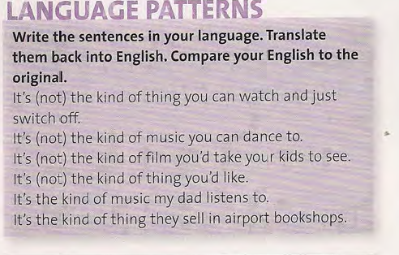

Slide 19
Conversation Practice
Work in pair. With a partner, have conversation starting Do you read/listen to music/watch TV/go to the cinema much? Ask further questions like those you heard in Listening. Use as much of the language from the today’s lesson.

Slide 20
Homework
SB: Reading section, page 13 Heard it all before.
SB: page 156 file 1, page 161 file 16, page 159 file 12
WB: page 4 Vocabulary section A (2pts)
WB: Developing Conversation (2pts)
WB: page 4 Grammar B (2 pts)
WB: read Language Note: strong and weak form.
Vocabulary

